Slide 1


Rumah Coding Course "Android Basic"
Studi Kasus Aplikasi "SekolahKu"
Day 2

Slide 2
Course Syllabus
Day 2
Form Validation
Intro to SQLite
Create Model
Save Data
List View
Array Adapter
Toast
Menus

Slide 3
Let's Refresh Previous Lesson
How many Layout we've learn so far?
What is LinearLayout?
What is RelativeLayout?
What is Activity?
What elements we need to create an activity?
To build a layout we use Java or XML?
To create an action we use Java or XML?

Slide 4
Object Oriented Programming
Object-oriented programming (OOP) is a programming language model organized around objects rather than "actions" and data rather than logic. Historically, a program has been viewed as a logical procedure that takes input data, processes it, and produces output data.
Examples of objects range from human beings (described by name, address, and so forth) to buildings and floors (whose properties can be described and managed) down to the little widgets on a computer desktop (such as buttons and scroll bars).

Slide 5
What is a Class?
In the real world, you'll often find many individual objects all of the same kind. There may be thousands of other bicycles in existence, all of the same make and model.
Each bicycle was built from the same set of blueprints and therefore contains the same components.
In object-oriented terms, we say that your bicycle is an instance of the class of objects known as bicycles. A class is the blueprint from which individual objects are created.

Slide 6
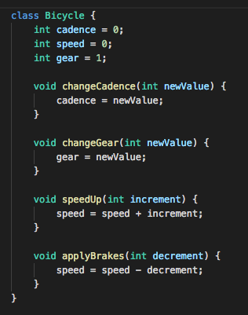
A Class of Bicyle

Slide 7
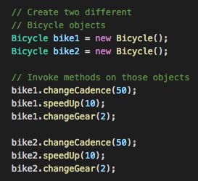
Accessing Class Member

Slide 8

Task #0 Create a class to represent an eagle. Share your code on pastebin.com

Slide 9
Evaluate Your Java Code
Variable name are case sensitive, ex:
Speed and speed are different variables.
Variable and Class Name must follow CamelCase rules, ex:
EagleBird
Student
IronMan
Class name must begin with upper case letter.
Variable name must begin with lower case letter.

Slide 10
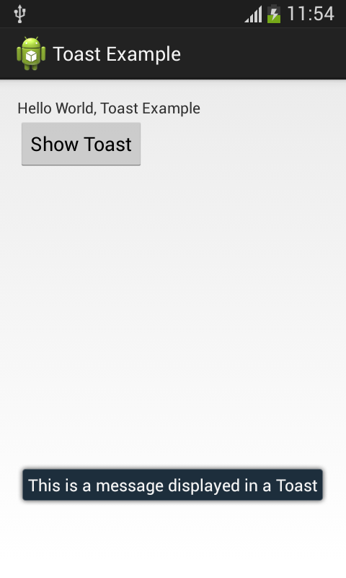

Toast
A toast is a view containing a quick little message for the user. The toast class helps you create and show those.

Slide 11
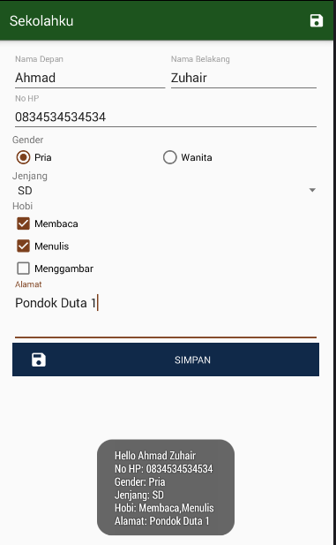
Task #1 Show all user input data (separated by enter) using toast when save button clicked

Slide 12
Android Screen Size
MDPI
HDPI
XHDPI
XXHDPI
XXXHDPI
Scale: 1x
320 X 480px
Scale: 1.5x
480 X 800px
Scale: 2.0x
720 X 1280px
Scale:3.0x
960 X 1600px
Scale: 4.0x
1440 x 2560px
Phone 3"
Phone 5"
Tablet 7"
Tablet 10"
Tablet 12"

Slide 13

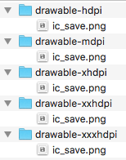
One Icon, 5 Different Sizes

Slide 14
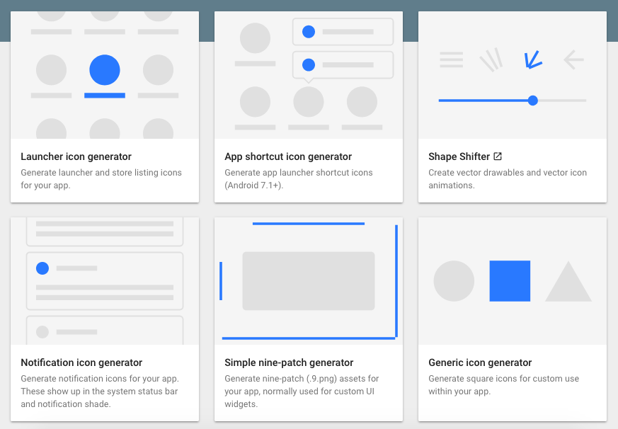
Save More Times, Use Android Asset Generator https://romannurik.github.io/AndroidAssetStudio/

Slide 15
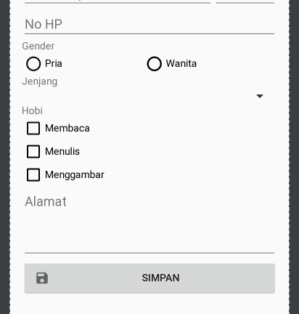
Task #2 Adding save icon on the save button

Slide 16
Menus
Menus are UI Component that provide shortcuts to an action or feature
Menus can be defined using XML and placed under res/menu folder
Menu item must have the following attributes:
id: Unique identifier of menu item within single xml file
icon: Icon for menu item, refers to image drawable resources.
title: Title for menu item
showAsAction (always, ifRoom, never): When and how this item should appear as an action item in the app bar. A menu item can appear as an action item only when the activity includes an app bar

Slide 17
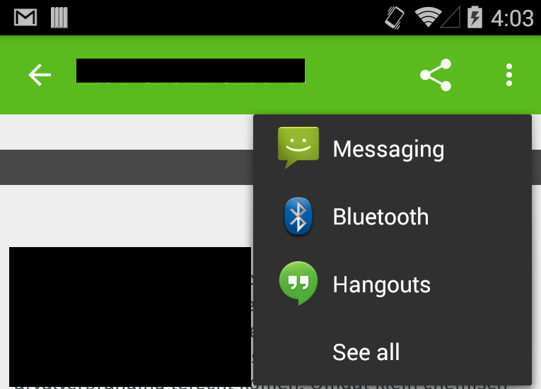
Menu showAsAction
always: Always place this item in the app bar.
never: Never place this item in the app bar.
ifRoom: Only place this item in the app bar if there is room for it

Slide 18
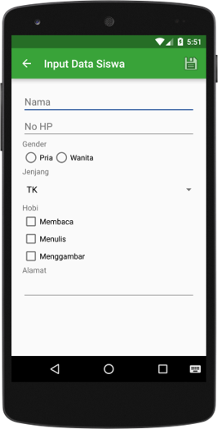
Task #3 Replace Save Button with save menu.

Slide 19
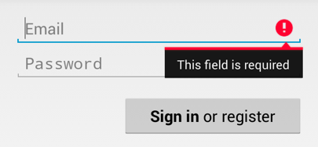

Form Validation

Slide 20
Task #4 Make Form Validation
All fields can not blank.
Nama Depan and Nama Belakang can't contain any special characters.
No HP field must be a number.
NO HP max length: 12

Slide 21
Introduction to SQLite
SQLite is a open source SQL database that stores data to a text file on a device. Android comes in with built in SQLite database implementation.
SQLite supports the following data types:
TEXT(similar to String in Java)
INTEGER (Similar to long in Java)
Real (similar to double in Java). All other types must be converted into one of these fields before getting saved in the database.

Slide 22
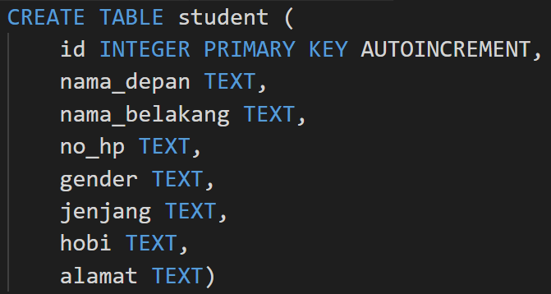
Auto Increment
SQLite AUTOINCREMENT is a keyword used for auto incrementing a value of a field in the table. We can auto increment a field value by using AUTOINCREMENT keyword when creating a table with specific column name to auto increment.

Slide 23
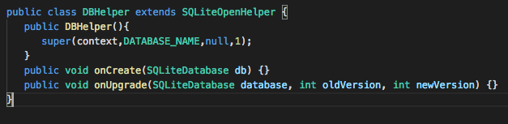
Database Helper
For managing all the operations related to the database, an helper class has been given and is called SQLiteOpenHelper. It automatically manages the creation and update of the database. Its syntax is given below:

Slide 24
Task #5 Create Completed DatabaseHelper extending SQLiteOpenHelper. Don’t forget to make your id autoincrement.

Slide 25
Data Source
Data Source is a final helper class that can be used to perform CRUD (Create Read Update Delete) operations. It used DatabaseHelper object to access the database instance.

Slide 26
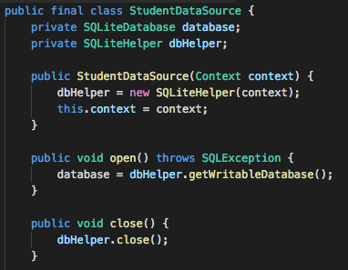
Task #6 Create Completed StudentDataSource

Slide 27
POJO (Plain Old Java Object)
POJO is a public class that represent model abstraction to the database table in SQLite.

Slide 28
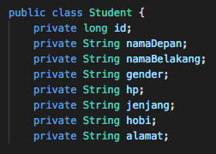
Task #7 Create new package: models and create new class: Student

Slide 29
Java Member Class Access
public: Can be accessed from anywhere.
protected: Can only be accessed within a class or from other class that extending the class.
private: Can only be accessed within the class.

Slide 30
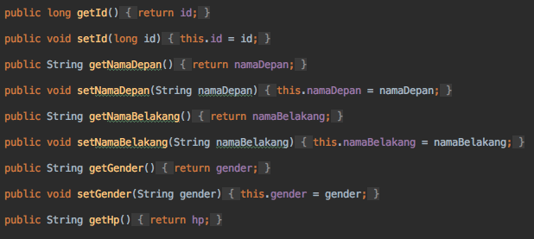
Task #8 Create Setter and Getter for all member in class Student

Slide 31
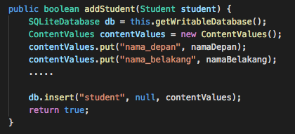
Task #9 Modify StudentDataSource, add new method: addStudent

Slide 32
Task #10 Modify FormActivity. Save student data into SQLite when the save button clicked instead of showing a Toast.

Slide 33
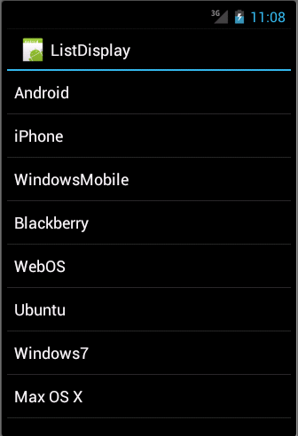
Introduction to List View
Android ListView is a view which groups several items and display them in vertical scrollable list. The list items are automatically inserted to the list using an Adapter that pulls content from a source such as an array or database.

Slide 34
Task #11 Add new Activity: ListActivity. It should contains a single List View. We will use it to display all students from database.

Slide 35
Cursor
A Cursor represents the result of a query and basically points to one row of the query result. This way Android can buffer the query results efficiently; as it does not have to load all data into memory.
To get the number of elements of the resulting query use the getCount() method.
To move between individual data rows, you can use the moveToFirst() and moveToNext() methods.
isAfterLast() method allows to check if the end of the query result has been reached.

Slide 36
Get Data from Cursor
Cursor provides typed get*() methods, e.g. getLong(columnIndex), getString(columnIndex) to access the column data for the current position of the result. The "columnIndex" is the number of the column you are accessing.
Cursor also provides the getColumnIndexOrThrow(String) method which allows to get the column index for a column name of the table.
A Cursor needs to be closed with the close() method call.

Slide 37
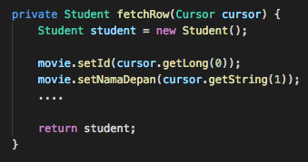
Task #12 Modify StudentDataSource, add new method: fetchRow This method will fetch student data from cursor then return student object.

Slide 38
Query from Database
You can use method rawQuery() from a database instance to query an SQL statement.
The method will return Cursor to the result data.
You can iterate the cursor object to get all the data.

Slide 39
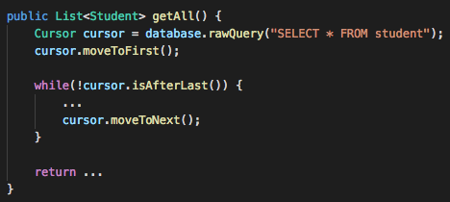
Task #13 Modify StudentDataSource, add new method: getAll() This method will return List of Student.

Slide 40
What is List in Java?
List is a collection of element with similar type.
Elements can be inserted or accessed by their position in the list, using a zero-based index.
A list may contain duplicate elements.

Slide 41
Task #14 Create a List consists of 10 students.

Slide 42
What is Array Adapter?
An adapter is an object that provides views for a list view. Whenever list view needs to draw a view at a particular list position, it gets it from the adapter. The adapter makes the view for that position and returns it.

Slide 43
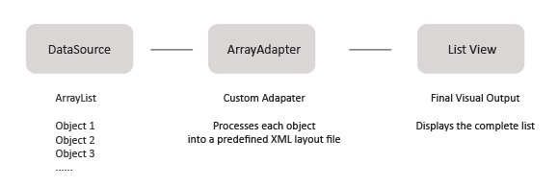
What is Array Adapter?

Slide 44
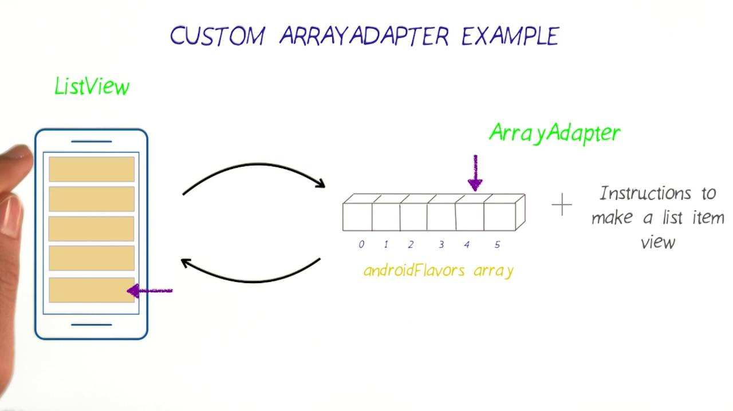
What is Array Adapter?

Slide 45
Task #15 Modify ListActivity: Display all student's name in the List View

Slide 46
- Add menu item (plus.png) into ListView, when the menu item clicked, open FormActivity. - Close FormActivity when save menu item clicked - Add Birth Date (Date Picker) and Email (Edit Text) to FormActivity. - Validate Form: Not Empty, Valid Date, Valid Email Address. - Save to database - Show email below student'name on the List View
HomeWork

